Slide 1
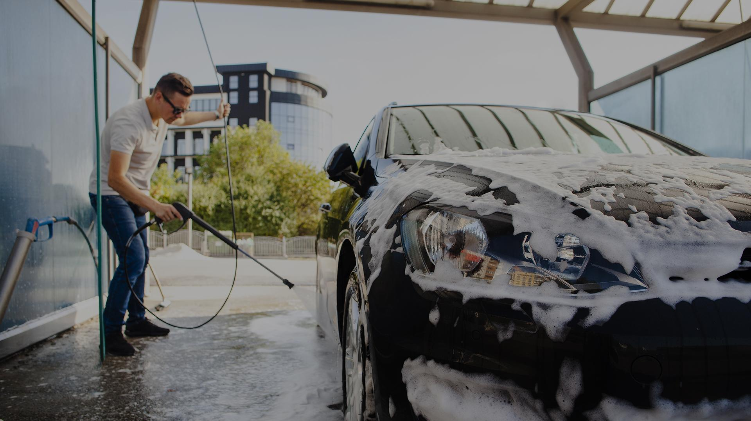

NAQI WASH

Slide 2
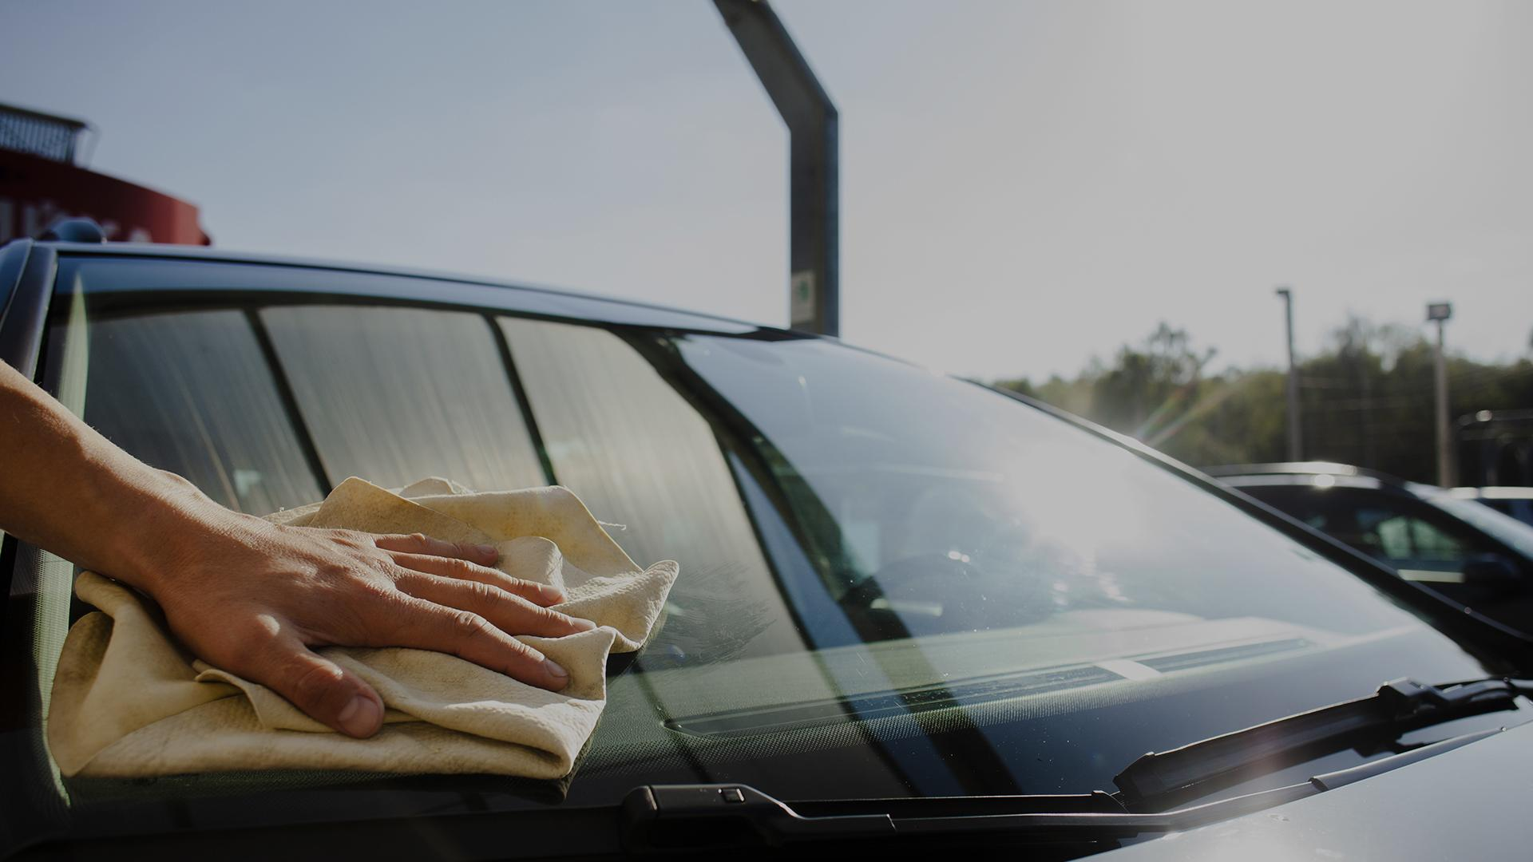
Supervisor
Eng. Ahmed Mamdouh
Team member
Reham Samir
Weam Gamal
Menatallah Ayman
Mahmoud Khalifa
Mohamed Refaat

Slide 3
TABLE OF CONTENTS
01
02
03
04
05
Introduction
System Overview
Used Technologies
How does it work
Live Demo

Slide 4
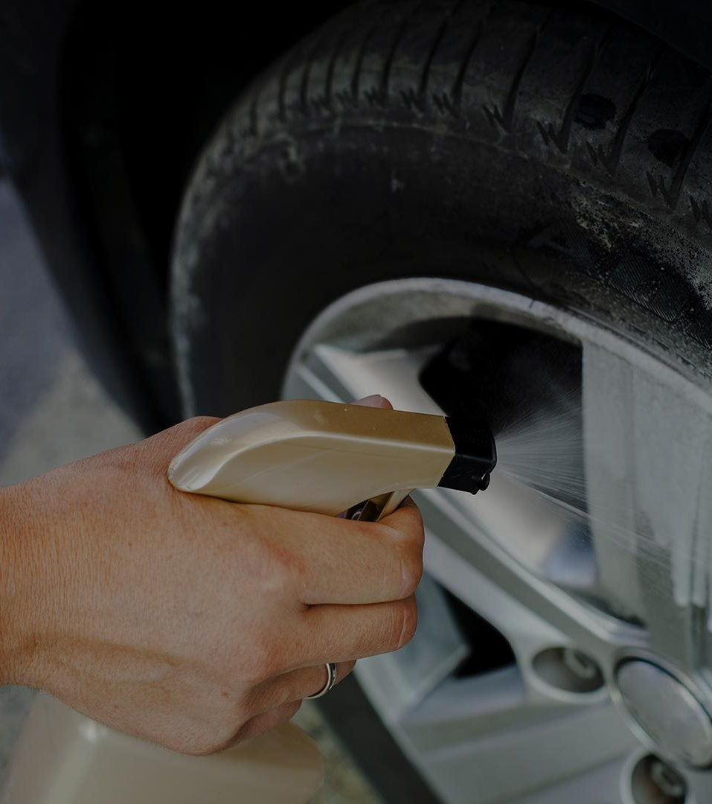
01
INTRODUCTION

Slide 5
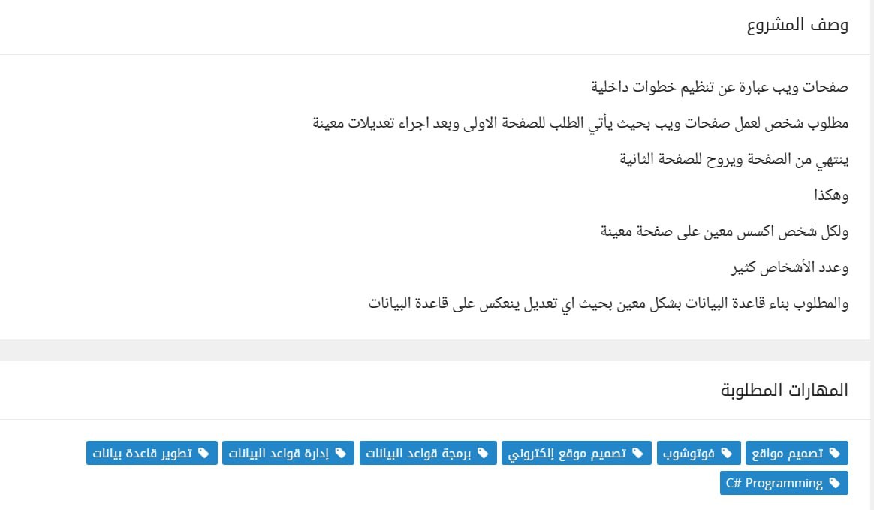
System Requirement

Slide 6
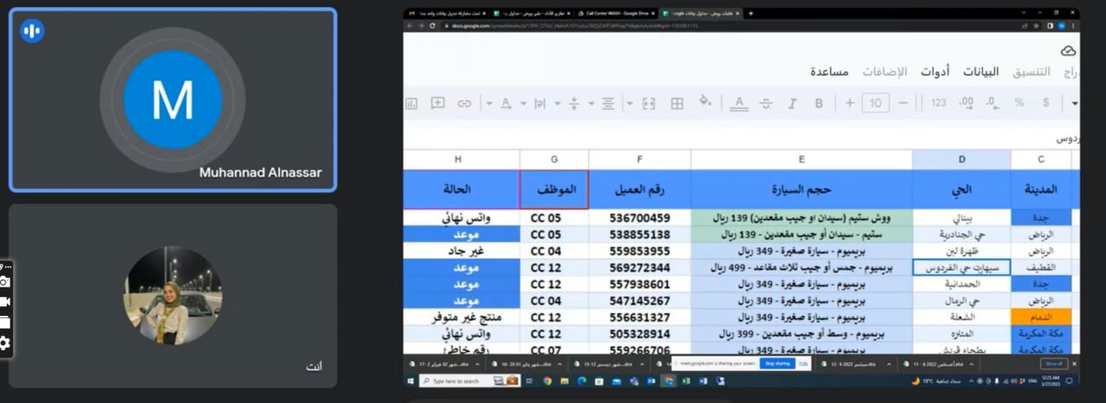
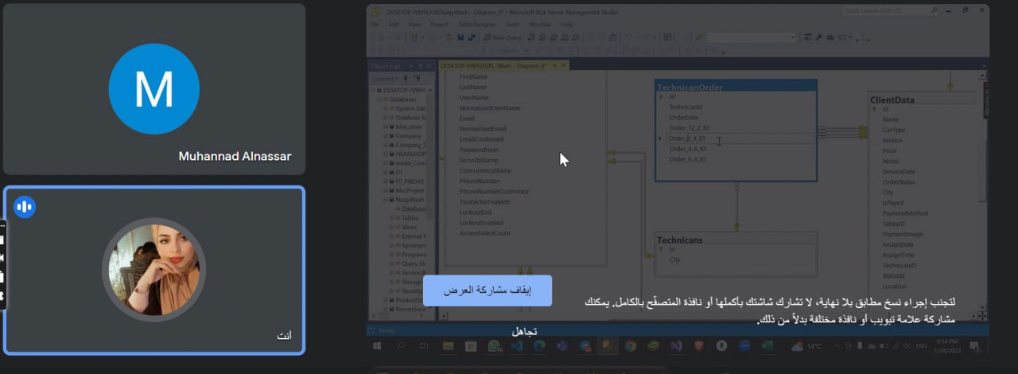
Meetings

Slide 7
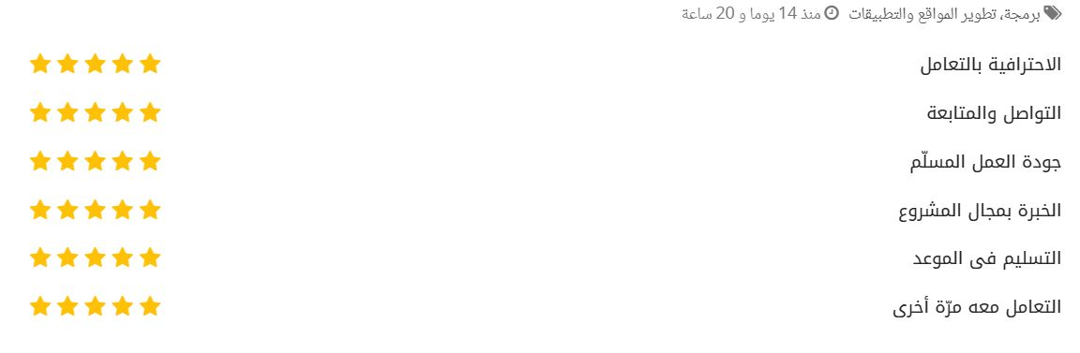
Project Evaluation

Slide 8
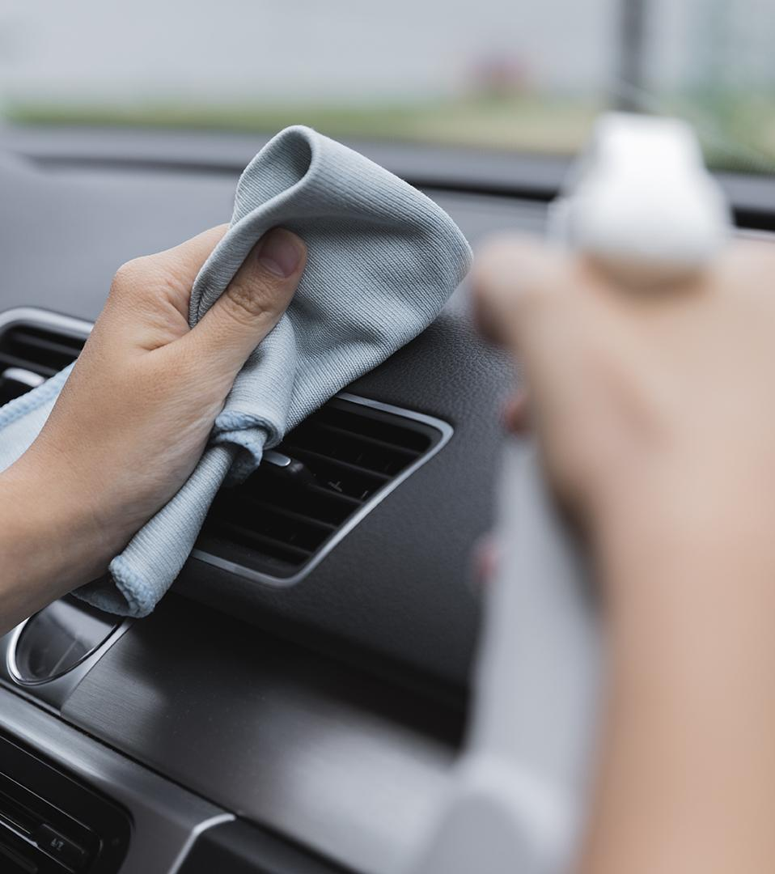
02
SYSTEM OVERVIEW

Slide 9
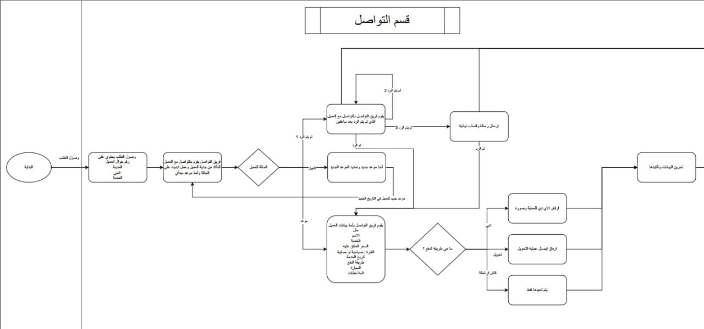
ERD

Slide 10
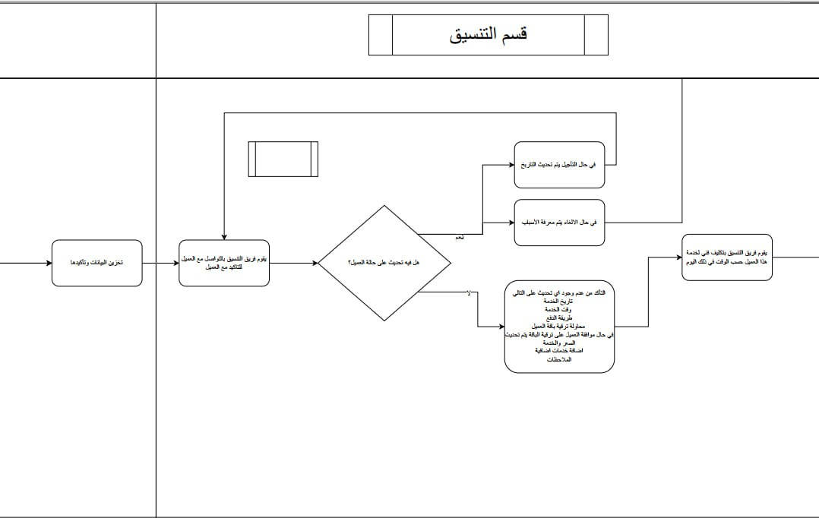
ERD

Slide 11
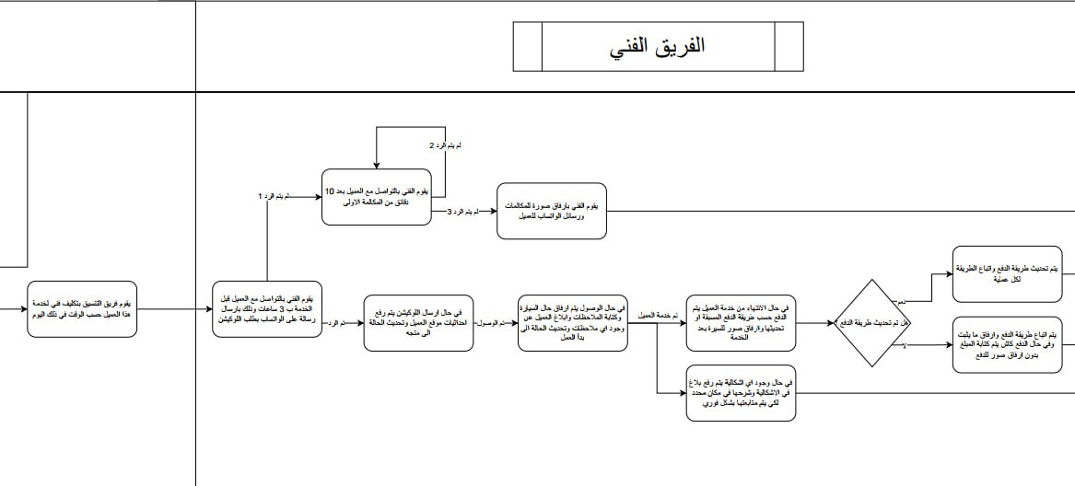
ERD

Slide 12
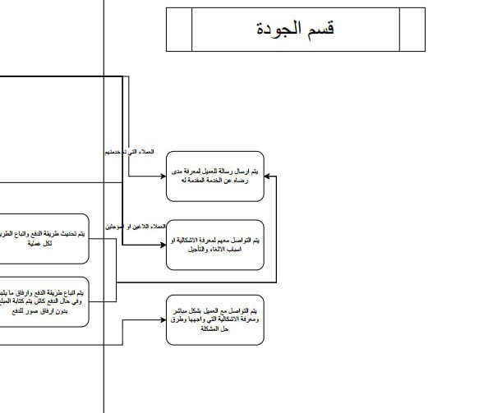
ERD

Slide 13
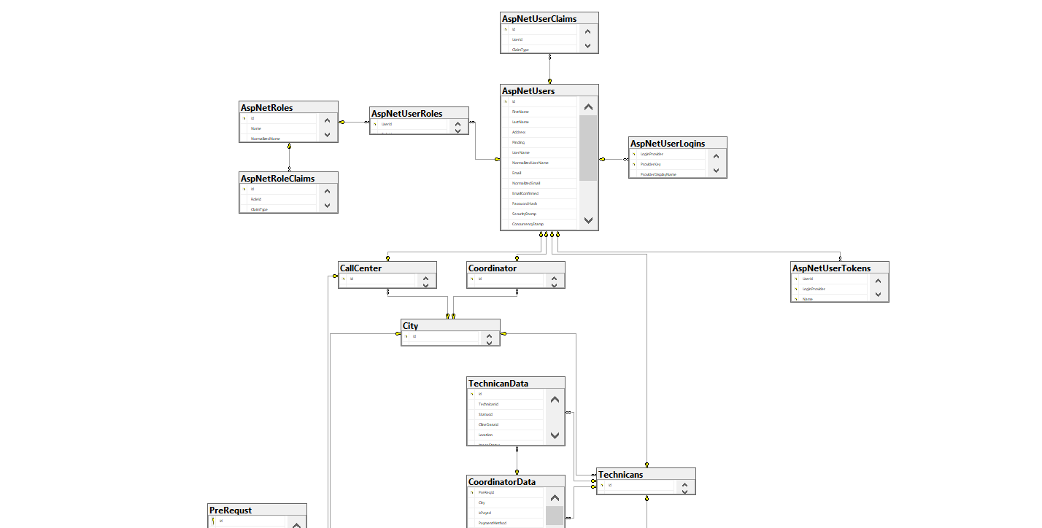
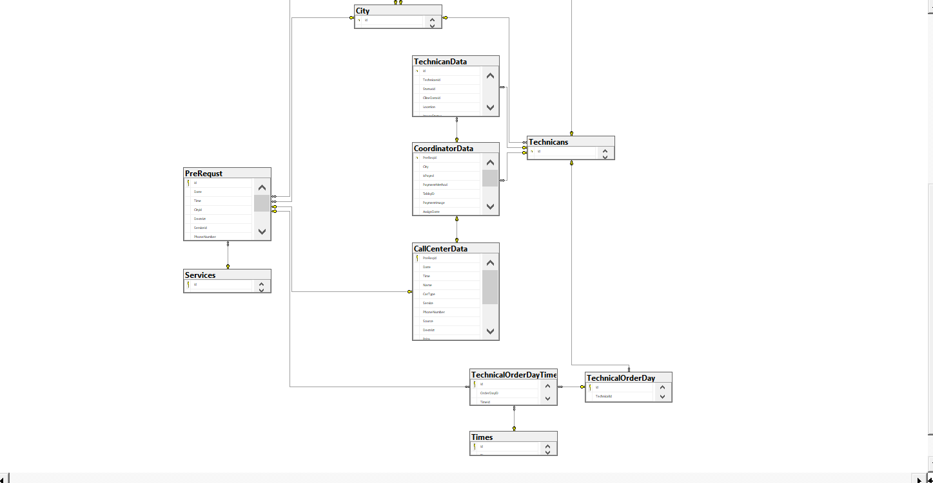
Database Diagram

Slide 14
03
Used Technologies

Slide 15
TECHNOLOGIES
01
02
03
MVC .Net Core
SQL Server
SignalR

Slide 16

04
How does the system work

Slide 17
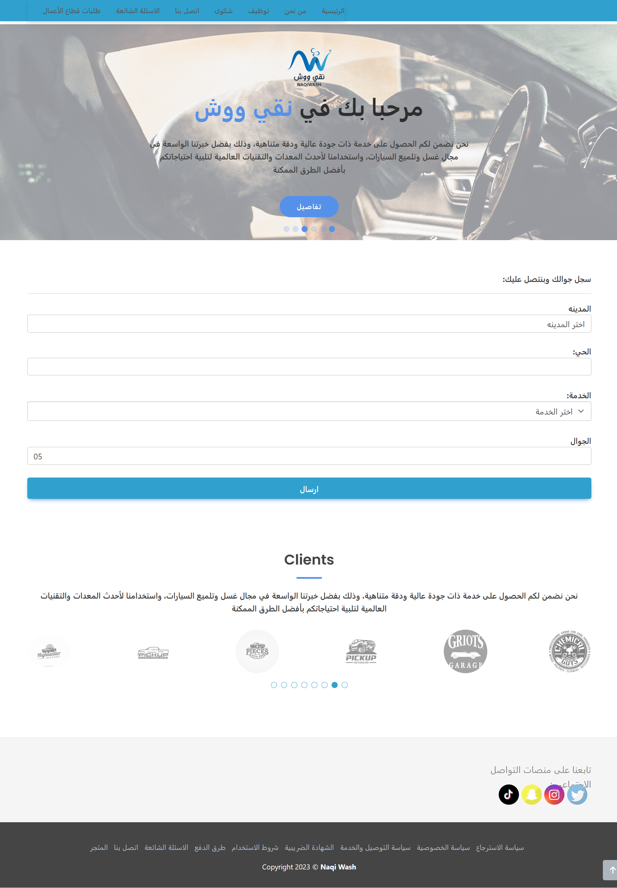

Slide 18
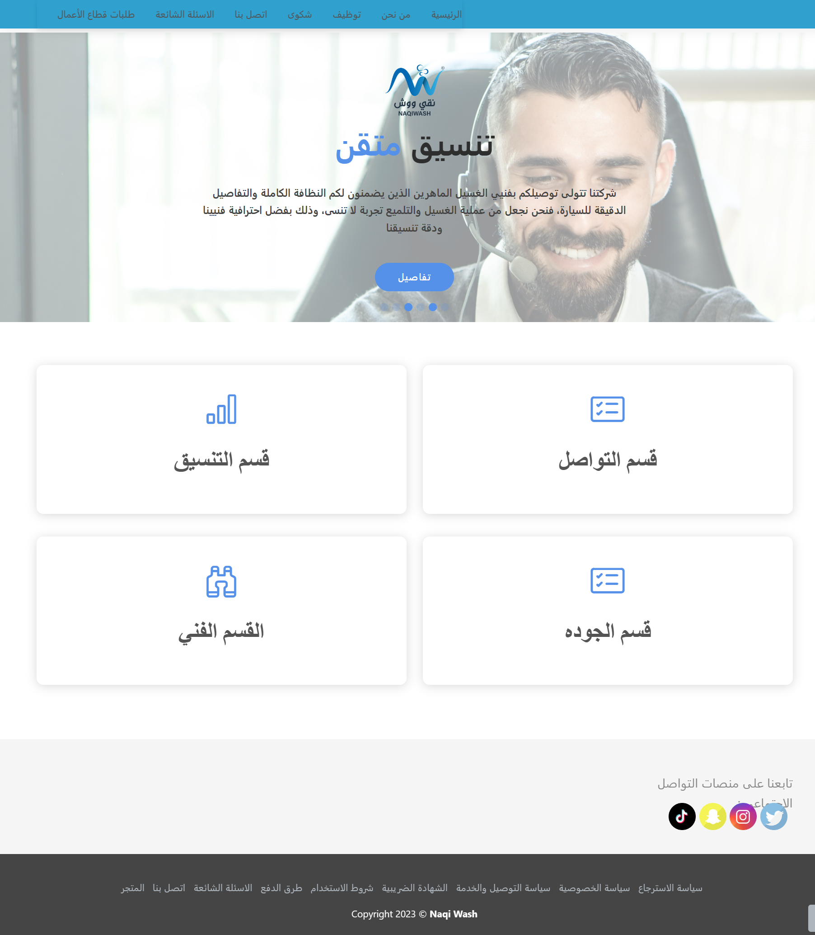

Slide 19
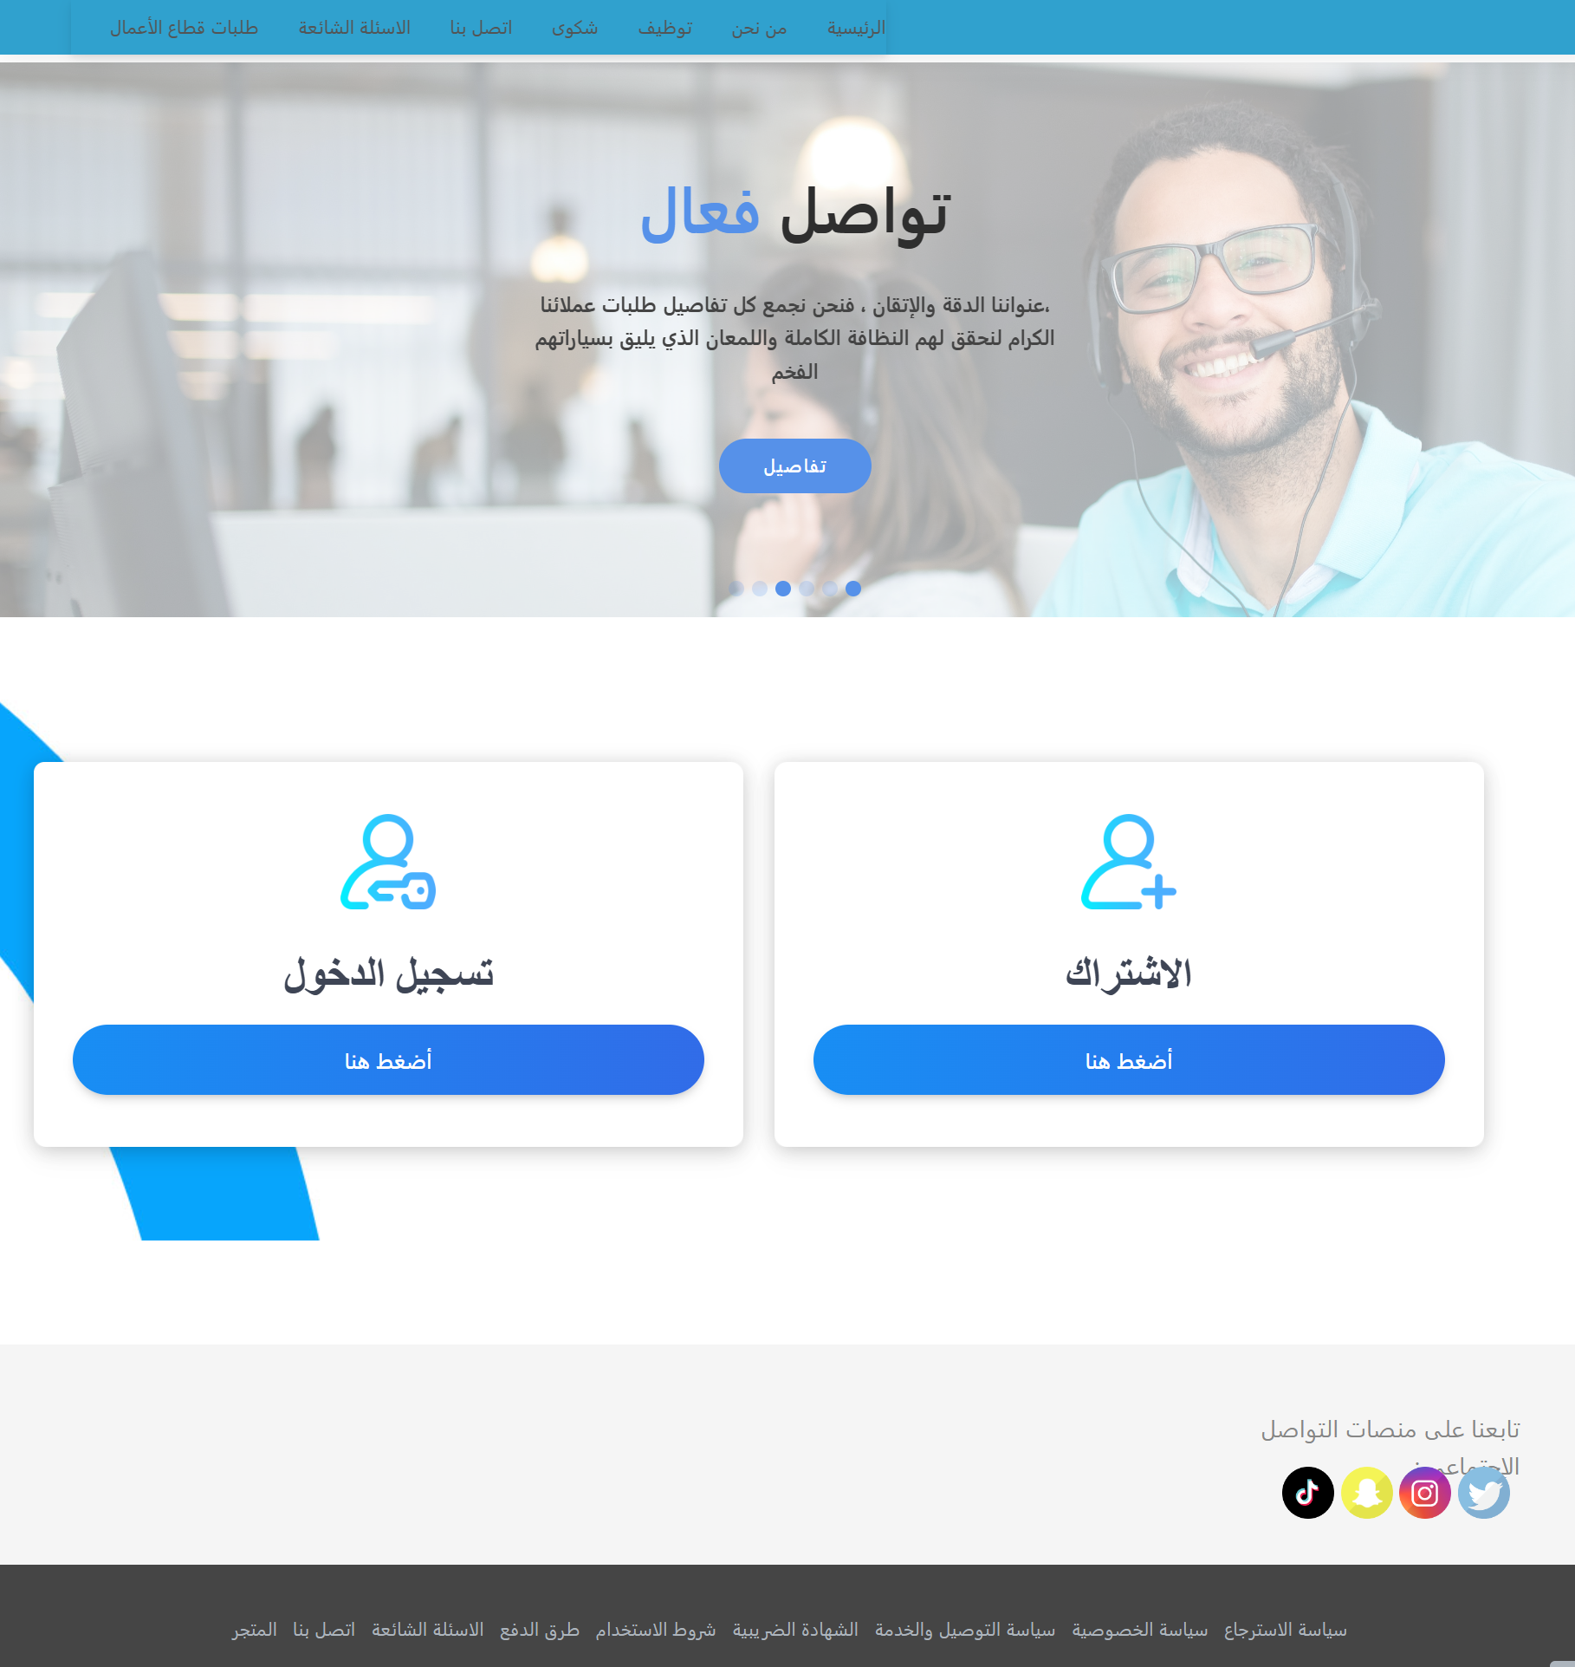

Slide 20
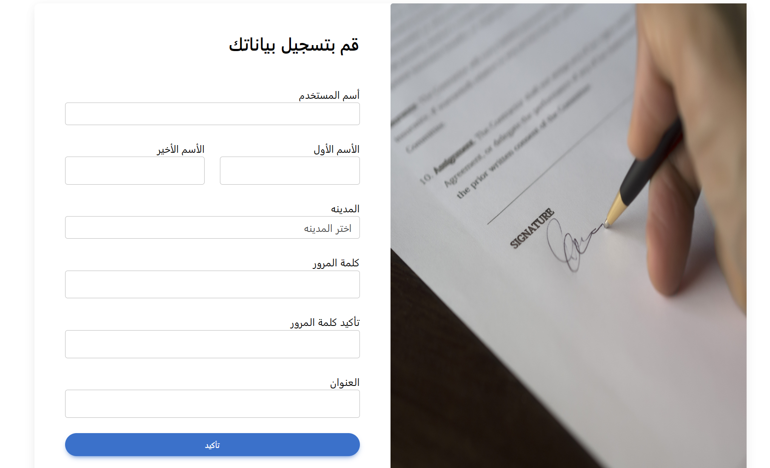

Slide 21
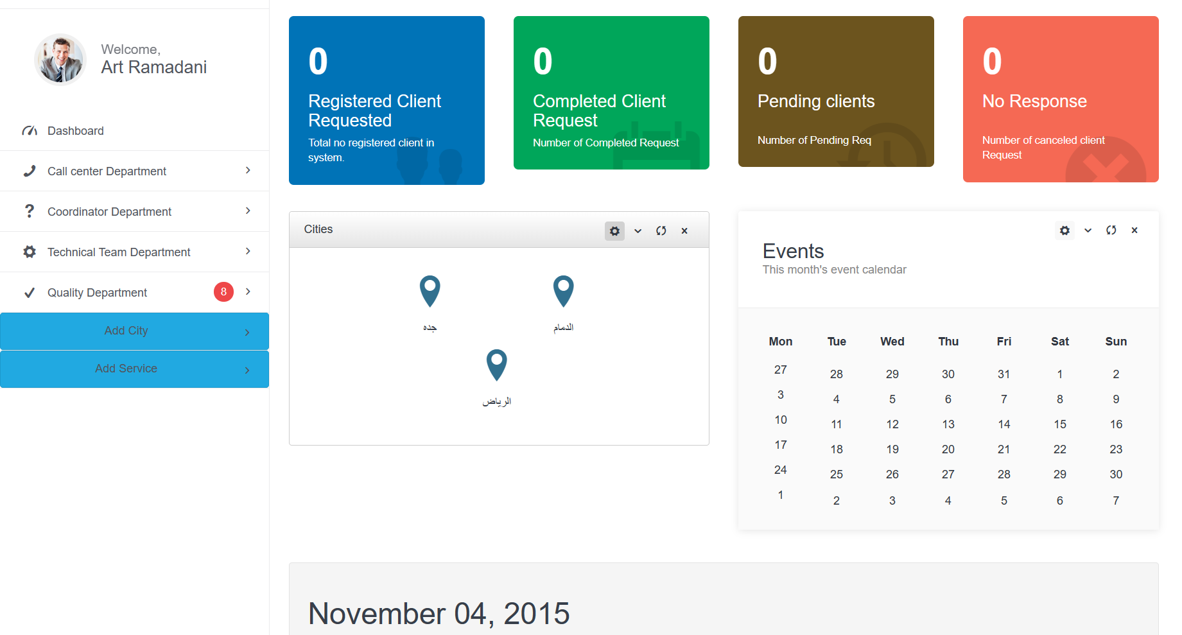

Slide 22
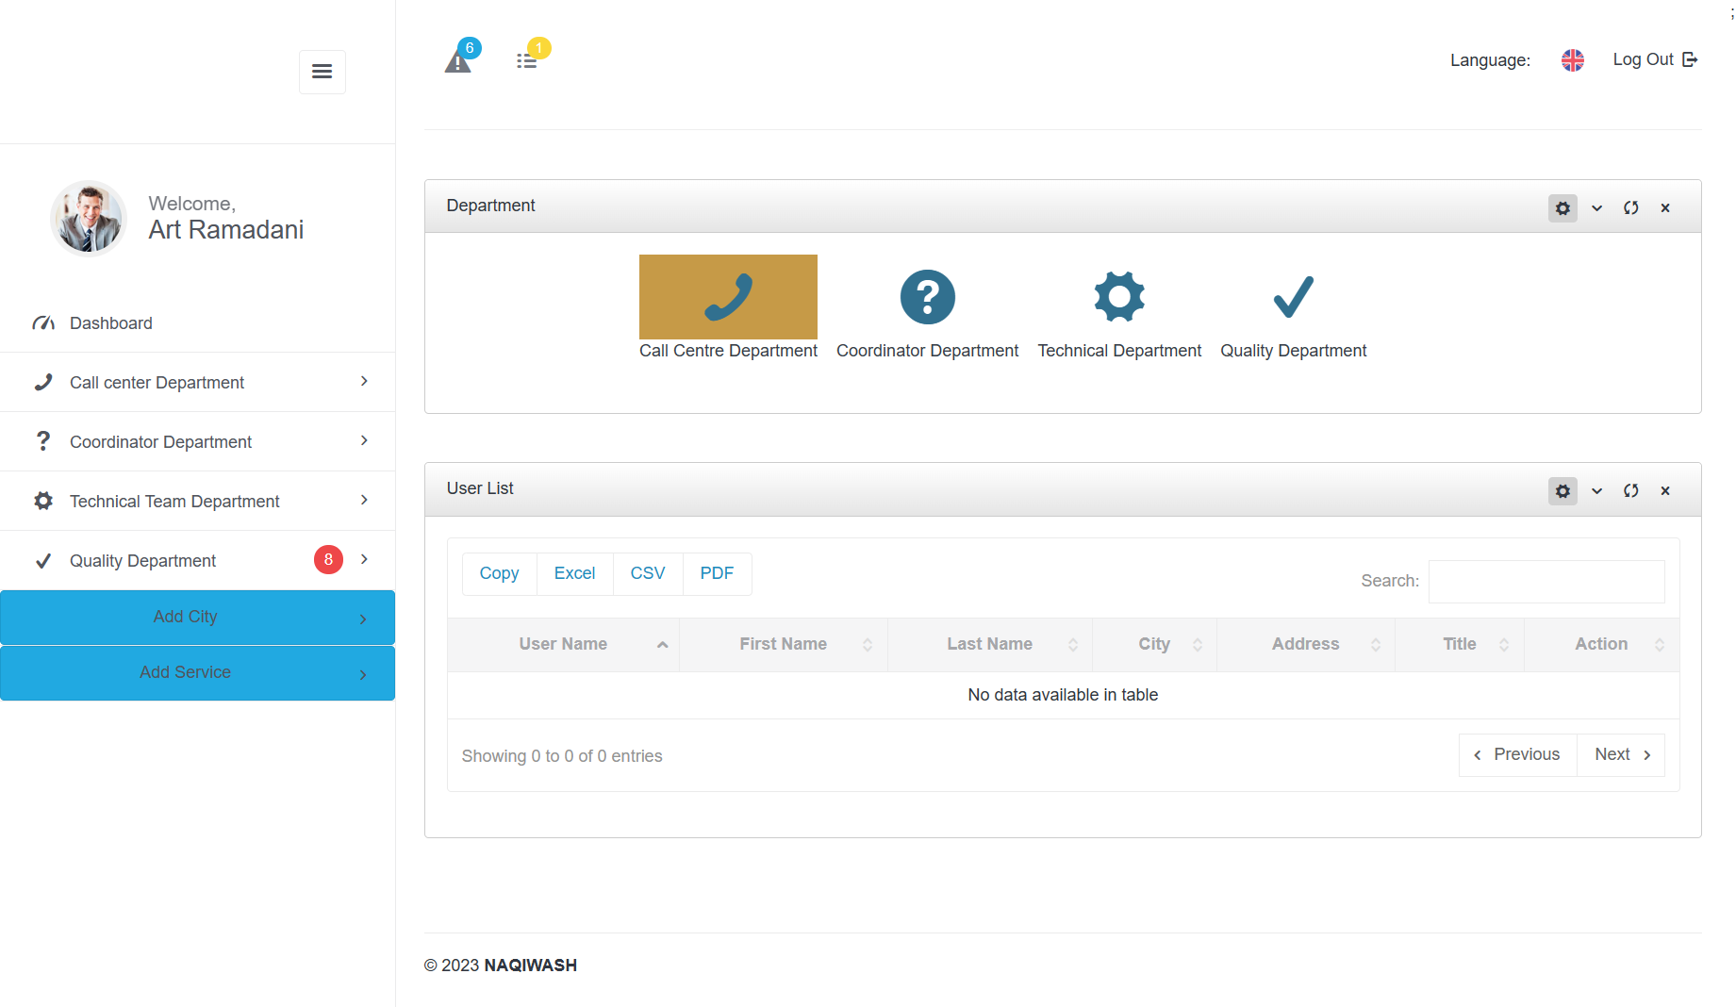

Slide 23
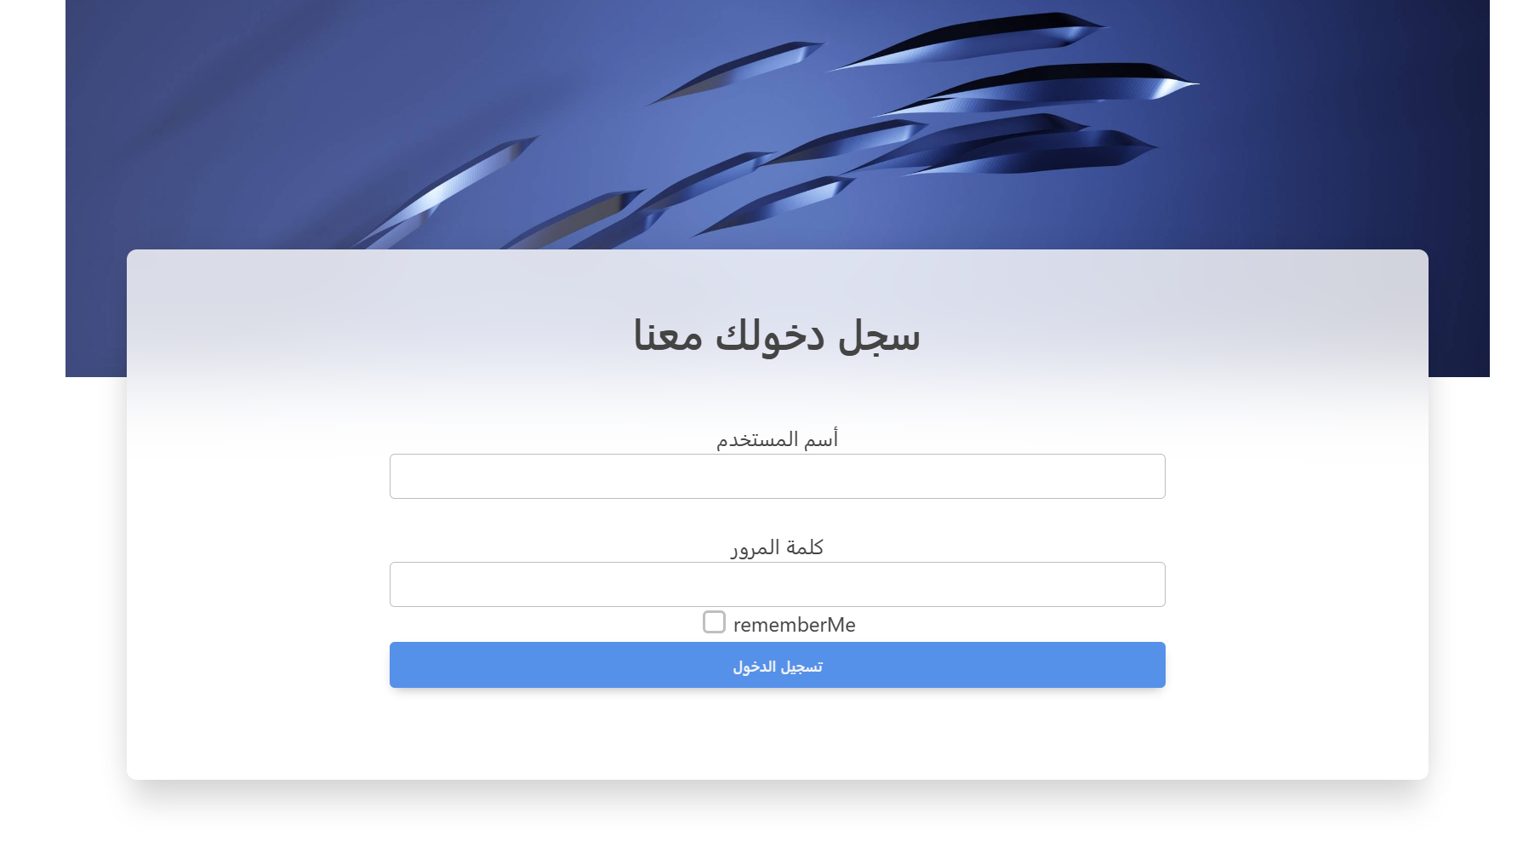

Slide 24
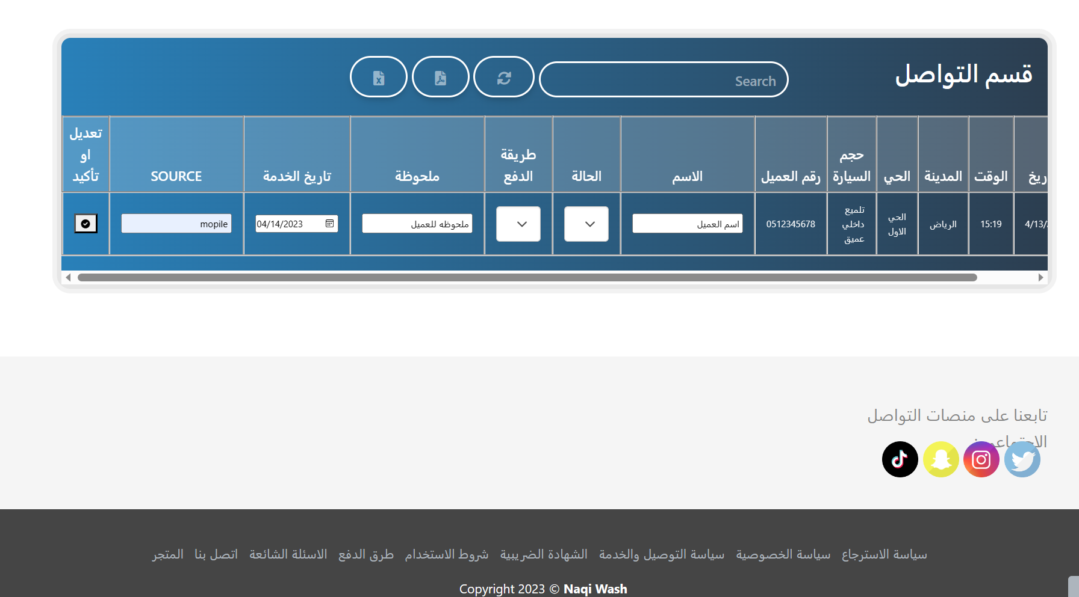

Slide 25
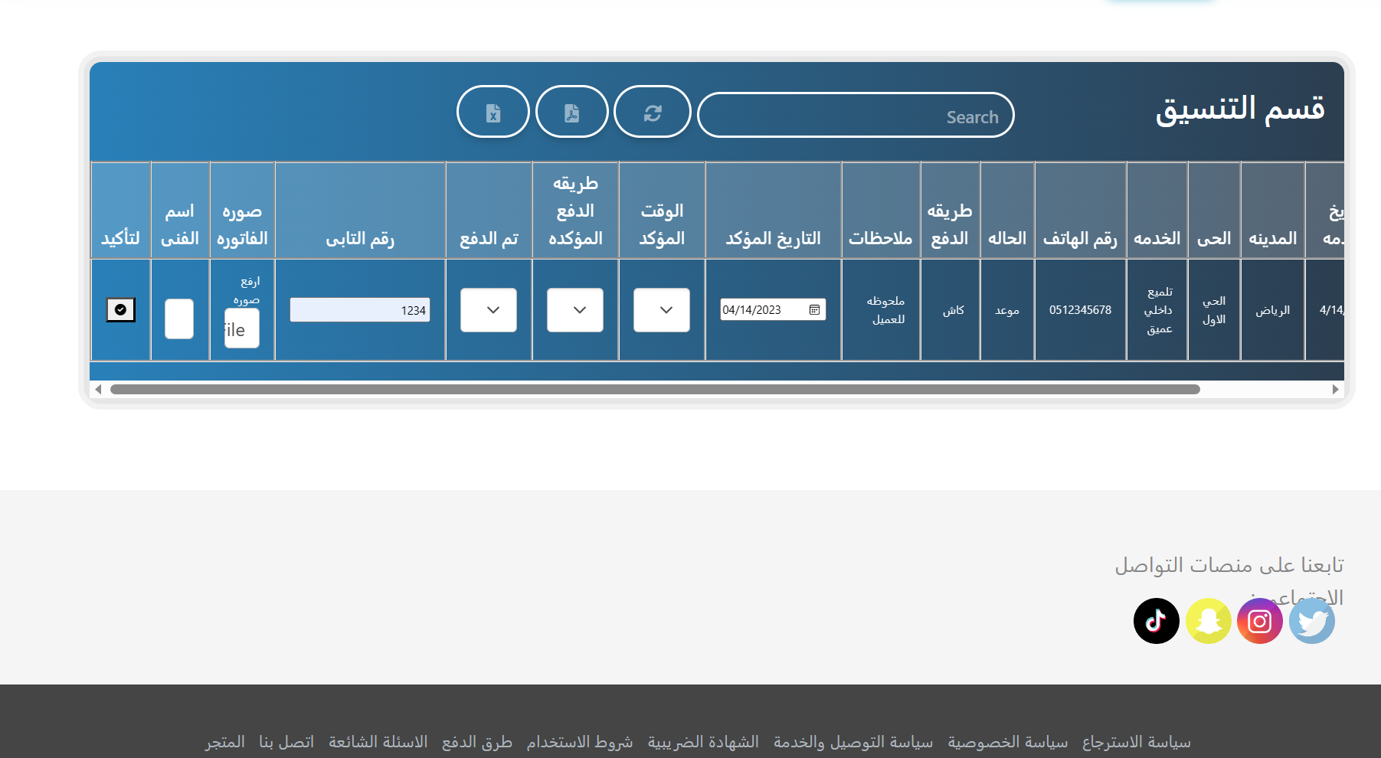

Slide 26
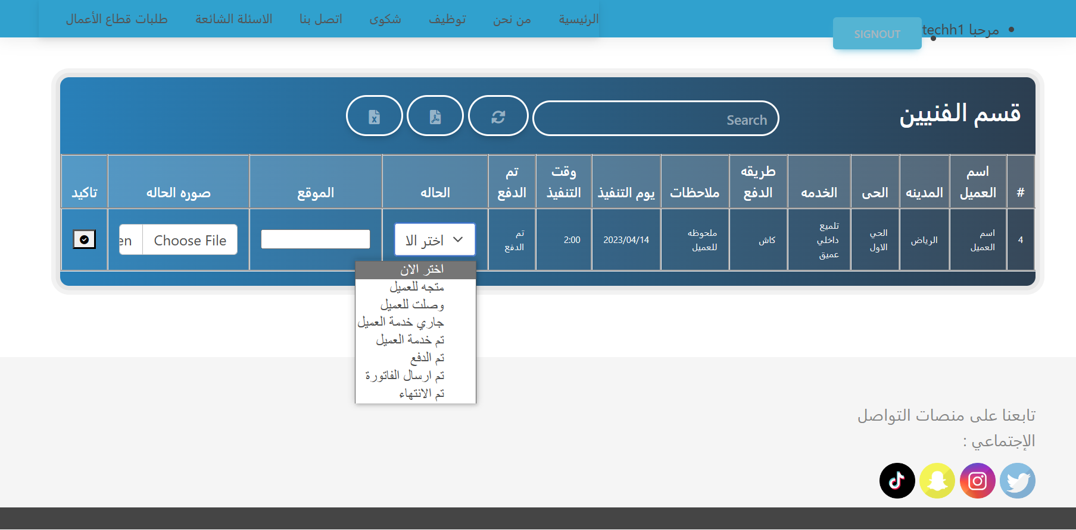

Slide 27

05
Live Demo

Slide 28

THANK YOU

